Slide 1
Statistical Mechanics
Monte Carlo method for the Ising model

Slide 2
Computer simulations in statistical mechanics
Two main categories:
Monte Carlo
Molecular Dynamics
They both rely on importance sampling

Slide 3
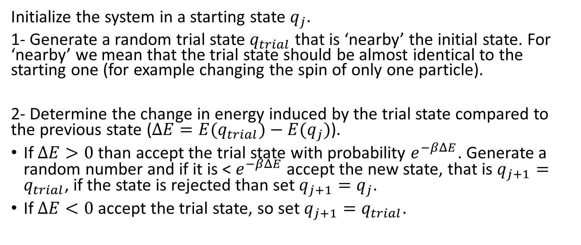
Metropolis algorithm
Initialize the system in a starting state $q_{j}.$
1- Generate a random trial state $q_{trial}$ that is ‘nearby’ the initial state. For ‘nearby’ we mean that the trial state should be almost identical to the starting one (for example changing the spin of only one particle).
2- Determine the change in energy induced by the trial state compared to the previous state ($ΔE={E(q}_{trial})−{E(q}_{j})$).
If $ΔE>0$ than accept the trial state with probability $e^{−βΔE}$. Generate a random number and if it is < $e^{−βΔE}$ accept the new state, that is $q_{j+1}=q_{trial}$, if the state is rejected than set $q_{j+1}=q_{j}$.
If $ΔE<0$ accept the trial state, so set $q_{j+1}=q_{trial}$.

Slide 4

Metropolis algorithm
3- Perform steps 1 and 2 for all particles or spins in the system, Steps from 1 to 3 define a Monte Carlo sweep.
4- Perform $M_{eq}$ Monte Carlo sweeps in order to let the system equilibrate

Slide 5
Ising Model simulation
I have developed a program which shows the phase transition in the 2d ising model.
The simulation i have done is written in python on Jupyter notebook and optimized with cython.

